Slide 1
A Comparative Study: MongoDB vs. MySQL
Kaan Dura

Slide 2
Introduction
Relational DBs handle structured data but struggle at large scale.
NoSQL introduced to handle high-volume, unstructured data.
Not Only SQL - a milder variant of the definition, compared to usual anti relational definition

Slide 3
Strategies for storing data in Non-relational databases
Key-Value Databases: Work like distributed dictionaries. Schema-less, Ex: Riak
Document: Extension of key-value model where values are documents (JSON, BSON, XML). Schema-less, Ex: MongoDB
Column-Oriented: Store data in columns grouped into column families rather than rows. Schemas, Ex: HyperTable
Graph: Model data as nodes (entities) and edges (relationships), Schema-less. Ex: Neo4j

Slide 4
Relational vs Non‑Relational
MySQL uses tables, fixed schema, relations.
MongoDB uses collections, documents, flexible schema.
No schema migrations required in MongoDB.

Slide 5
MongoDB Data Model
Data stored as BSON documents.
Supports embedded documents and dynamic structure.
Suitable for hierarchical and flexible datasets.

Slide 6
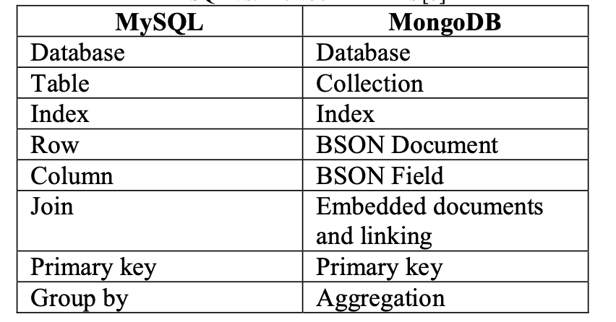
MySQL vs MongoDB Terms

Slide 7
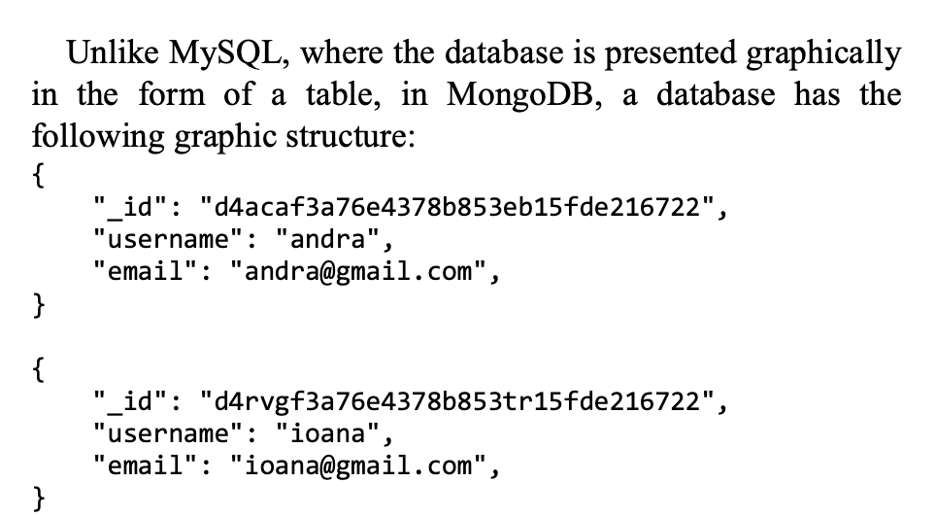
Data Representation

Slide 8
Use Case in the Study
A forum system where users create forums and subforums.
MongoDB allowed dynamic, nested forum structures.
MySQL required rigid predefined schema.

Slide 9
Performance Test Setup
Hardware: Intel i3, 4GB RAM, Windows 7.
Operations tested: Insert, Select, Update, Delete.
Same dataset and logic used for both DBs.

Slide 10
Insert Performance
The test started with the creation of databases without any content. The tables have the same number of columns/fields and tables/documents.
Users, id, username, password, email
Forums, id, title, author, info
Subforums: id, title, author, info, created, updated
Discussions: id, title, author, created, updated, content
Comments: id, author, created, content, approved
MySQL also requires columns for foreign keys

Slide 11
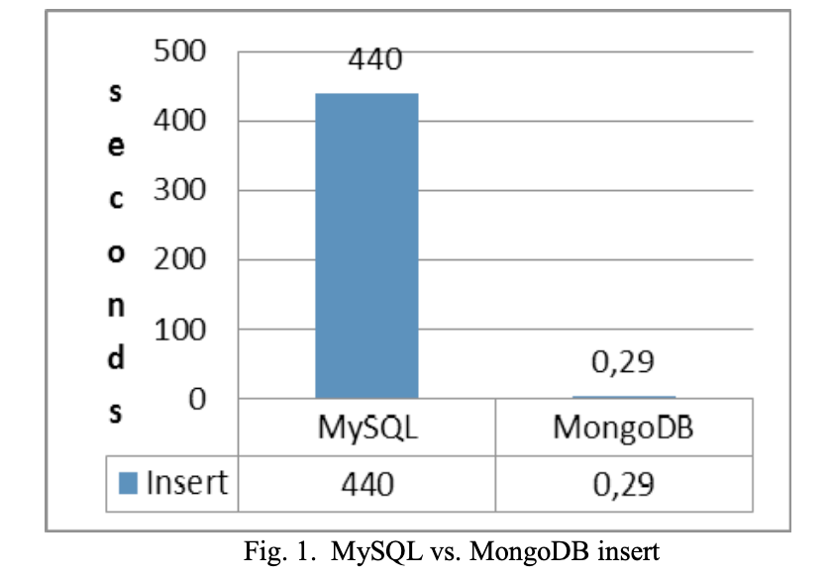
Insert Performance - 2
10000 users were inserted, the ids are generated automatically

Slide 12
Insert Performance - 3
For the other tables 5000 documents were inserted for each of them.
MySQL took 1010 seconds, MongoDB took 3.3331 seconds
Conclusion: MongoDB is more performant than MySQL, for insertion of large amount of information in the database

Slide 13
Query Performance
To test the performance of query operations, two select queries were executed.
Selection of all discussions a user attended and with a date different than a certain one
Selection of all users from the database and the number of discussions started by each user

Slide 14
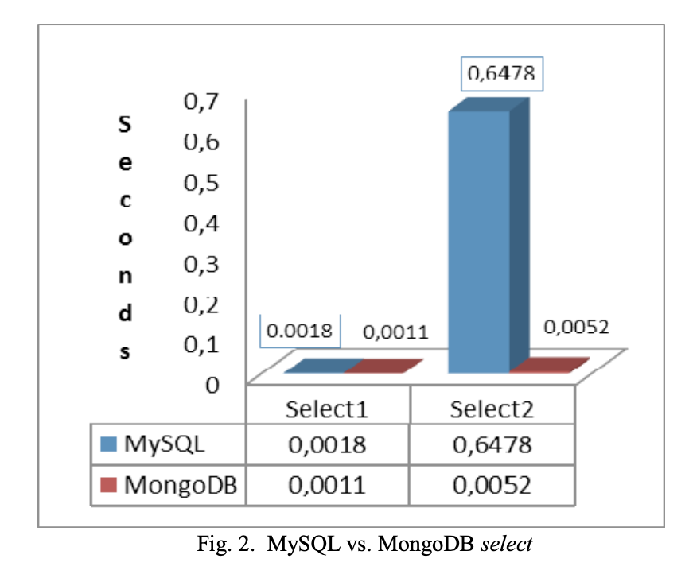
Query Performance - 2

Slide 15
Update Performance
To test update operations two queries were executed
Updating a comment written by a specific user
Updating the email address of a user

Slide 16
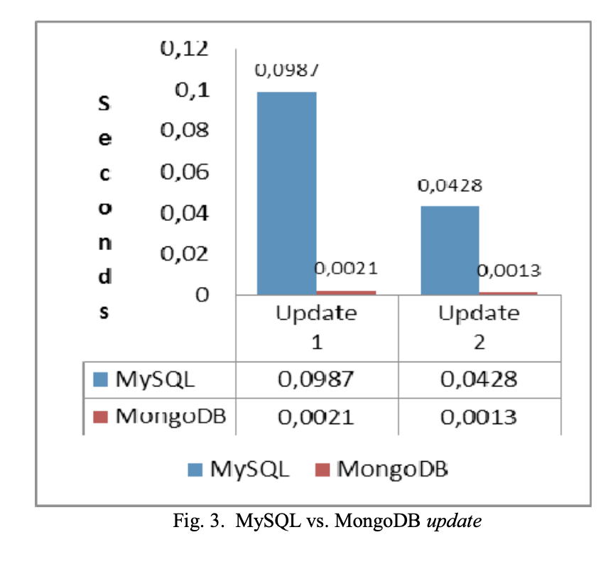
Update Performance - 2

Slide 17
Delete performance
Two delete queries were executed for each database
First query deleted all the comments posted by a user
Second query deleted all the forums created by a specific user
All of the associated data is also deleted

Slide 18
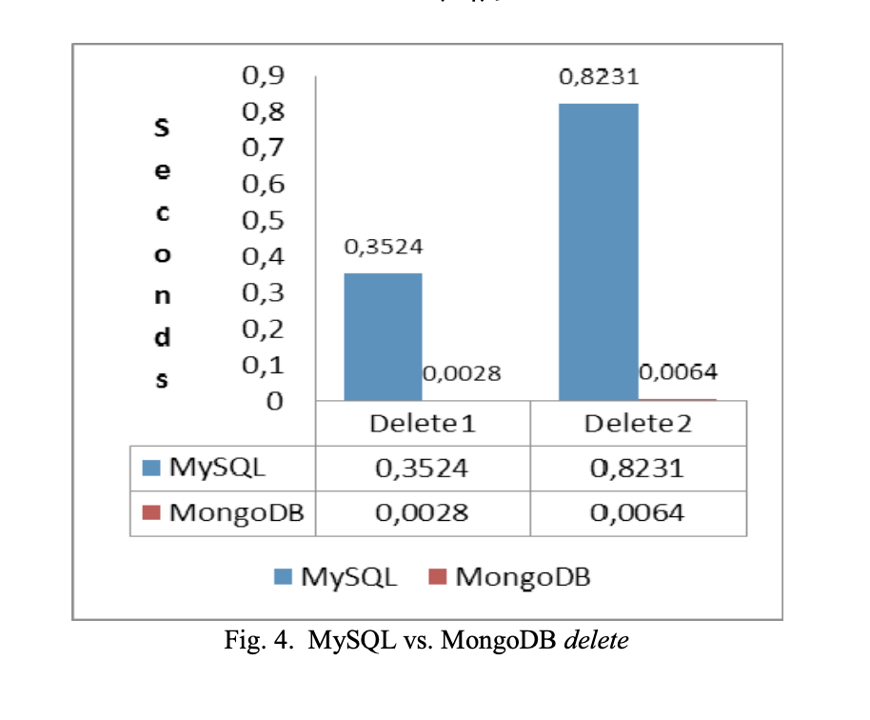
Delete Performance - 2

Slide 19
Conclusions
In spite of the results obtained, the use of relational databases will continue, mainly because of the feature sets provided and their data integrity and scalability.
For this application MongoDB is the most suitable database.
Although MongoDB doesn’t allow join operations references can be used to overcome this issue.
MongoDB can be chosen if the application is data intensive.
MongoDB allows total customization.

Slide 20
Bonus
https://www.youtube.com/watch?v=b2F-DItXtZs

